Slide 1


STUDY ON THE FACTORS AFFECTING THE INCIDENCE OF GESTATIONAL DIABETES IN FEMALE PATIENTS
By SHREYASI MONDAL
STSA , SEMESTER - 6
ROLL NO. : 3-14-21-0420
REG NO. : 041-1212-0276-20

Slide 2

WHAT IS GESTATIONAL DIABETES (GDM) ?
Diabetes during Pregnancy reduced insulin elevated level of glucose
MOTIVATION OF OUR STUDY
Paper on “ Population Health Significance of Gestational Diabetes” by N. Wah Cheung; Karen Byth
Woman during pregnancy has high risk of GDM high risk of diabetes short & long term effect on mother & offspring
Analysing data set prediction model help in early prediction reducing risk of both

Slide 3
Data Set
Source “ National Institute of Diabetes and Digestive and Kidney Diseases”

Slide 4





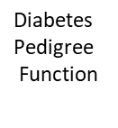
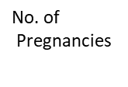




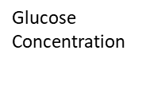







Variables present
in our data set
Notes:
Variables present
in our data set

Slide 5

METHODOLOGY
Step 1 : Data Visualization plotting the data set observe any pattern
Step 2 : Regression Diagnostics detecting outliers removing if any
Step 3 : Dividing data set Test data set(500 obs),Applied data set(rest obs)
Step 4 : Multicollinearity if any variable correlated with dependent var. & each other

Slide 6





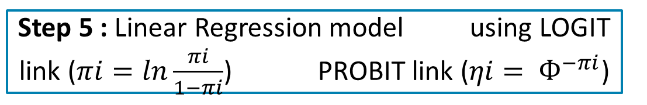
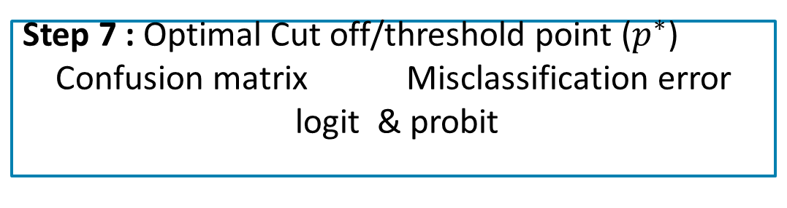
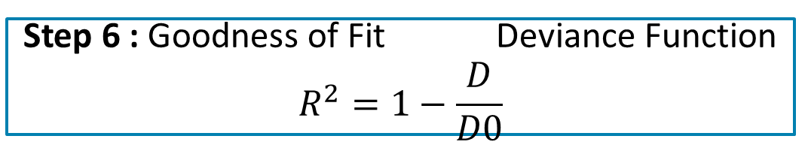
Step 5 : Linear Regression model using LOGIT link ($πi=ln\frac{πi}{1−πi}$) PROBIT link ($ηi= Ф^{−πi}$)
Step 6 : Goodness of Fit Deviance Function
$$R^{2}=1−\frac{D}{D0}$$
Step 7 : Optimal Cut off/threshold point ($p^{∗}$)
Confusion matrix Misclassification error
logit & probit
Step 8 : Testing of Significance of predictor select only significant ones
Step 9 : note all results from Applied data set
apply on Test data set

Slide 7
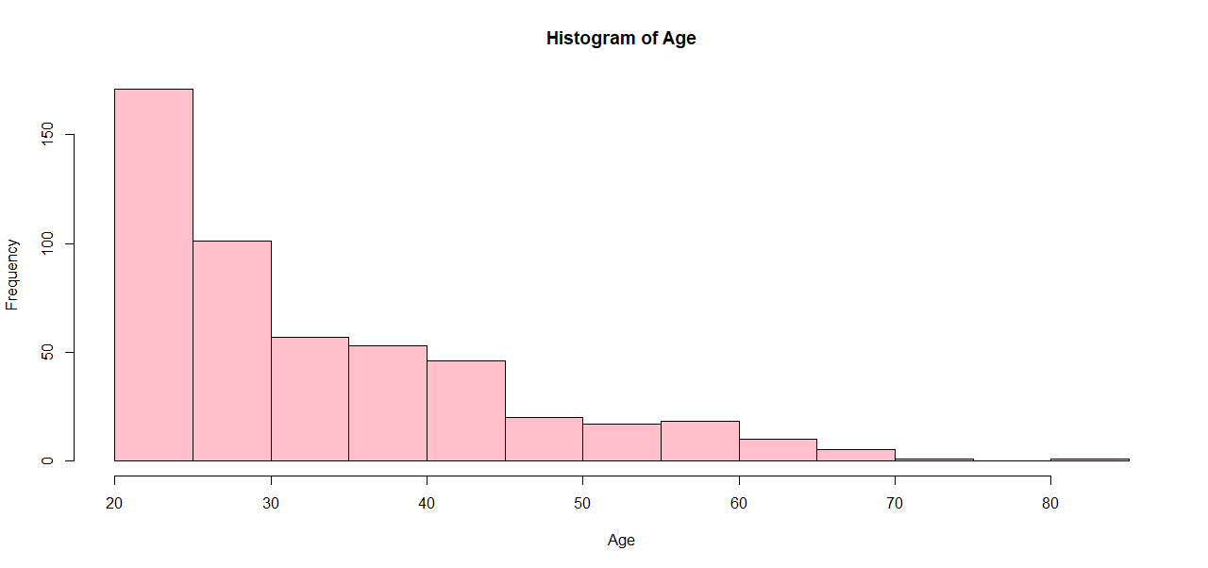
RESULTS
1) Graphs
Fig – 1.1
Comment : Most patients have ages between 21 - 30

Slide 8
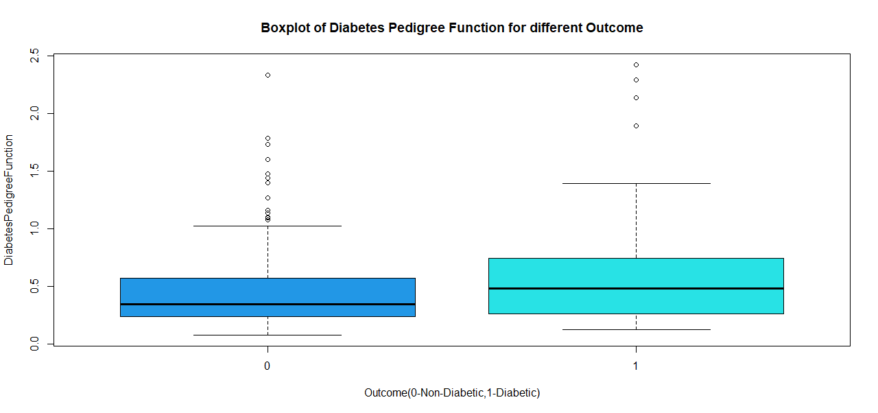


Fig – 1.2
Comment : On an avg Diabetes Pedigree Function greater in Diabetic individuals than non-diabetic ones outliers may be present.

Slide 9
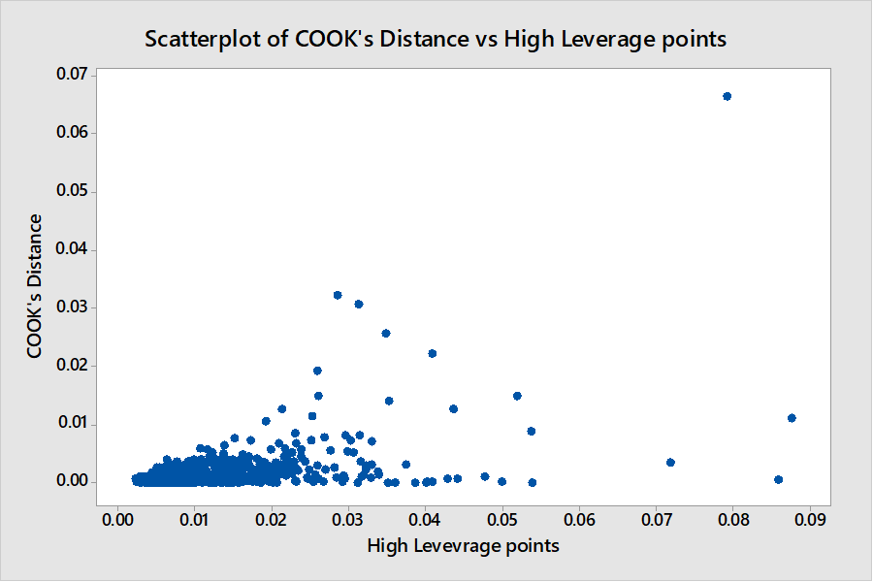
2) DETECTING OUTLIERS
Fig – 1.3
Comment : The obs above (229th obs) influential point deleting that point before further analysis.

Slide 10

3) MULTICOLLINEARITY :
Predictor Variables | VIF
Pregnancies (x1) | 1.3434
Glucose (x2) | 1.2638
Blood Pressure(x3) | 1.1315
Skin Thickness(x4) | 1.5647
Insulin (x5) | 1.5455
BMI(x6) | 1.1978
Diabetes Pedigree Function (x7) | 1.0335
Age (x8) | 1.4821
VIF of all the variables is less than 5 no MULTICOLLINEARITY

Slide 11



4) LINEAR REGRESSION MODEL USING LOGIT LINK
The fitted regression equation is given by ,
Y= - 7.7143 + 0.1159 x1 + 0.0313 x2 - 0.0098 x3 + 0.0025 x4
-0.0011 x5 + 0.0914 x6 + 0.9157 x7 + 0.0042 x8
Interpretation:
$\hat{β0}=−7.7143 :$all the other predictors are absent
takes the value 0 the odds of getting GDM decreases by $e^{−7.7143}$ times multiplicatively.
$\hat{β1}$ = 0.1159 : Keeping other predictors fixed the odds of having GDM increases by $e^{0.1159}$ times Pregnancies (x1) increases by one unit.

Slide 12


LINEAR REGRESSION MODEL USING PROBIT LINK
The fitted regression equation is given by,
Y= - 4.5471 + 0.0691 x1 + 0.0181x2 - 0.0054 x3 + 0.0011 x4
- 0.0007 x5 + 0.0538 x6 + 0.4968 x7 + 0.0038 x8
Interpretation :
$\hat{βj}$ : the change in the probability of having GDM
the j th predictor variable changes from 0.2 to 0.3 0.3 to 0.4 so on.
In short the Linear Probability Model assume marginal effect of xij on P(y=1) is constant.

Slide 13



5) GOODNESS OF FIT
Model using Logit link :
$R^{2} LOGIT=1− \frac{220.21}{336.36}$
= 0.345
Model using Probit link :
$R^{2} PROBIT=1− \frac{493.79}{655.68}$
= 0.2469
Comment : $R^{2}$ Logit is more than Probit Logit model gives better fit.

Slide 14


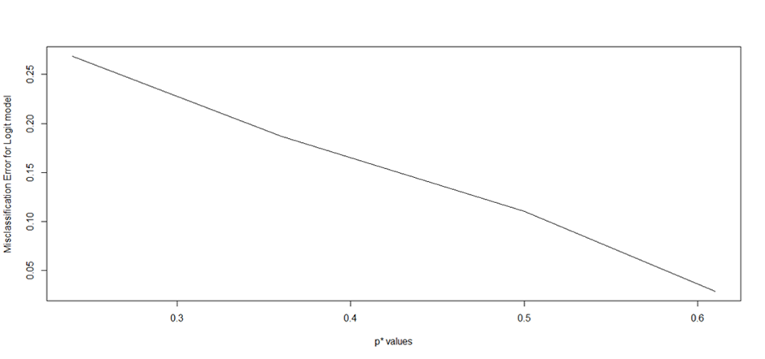

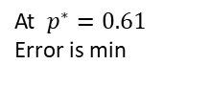

6) OPTIMAL CUT OFF & CONFUSION MATRIX
taking various combinations of p* as 0.24 the median of predicted values, 0.36 mean of the predicted values, 0.5 commonly used point optimal cut off point 0.61.
using the R software misclassification error for $\hat{pi}$values as 0.2684, 0.1869, 0.1103, 0.0291
Notes:
At $p^{∗}=0.61$
Error is min

Slide 15

COFUSION MATRIX
Predicted(y) Actual (Y) | 0 | 1
0 | 284 | 34
1 | 86 | 96
True Positive Rate (TPR) = P (Y=1| y =1)
= 0.7385
False Positive Rate (FPR) = P (Y=1| y =0)
= 0.2324
Total Probability of Misclassification
= 0.02911
error 0.02911 Very small Logit model good fit of the data set.

Slide 16


TESTIG OF SIGIFICANCE OF PREDICTORS
We are to test,
H𝑜𝑗: 𝛽0 = 0 vs H1: 𝛽1 ≠ 0 , for all j =1(1) 8
Coefficient | Z value | Decision
Pregnancies (1) | 3.023 | Reject
Glucose (2) | 6.970 | Reject
Blood Pressure (3) | -2.572 | Reject
Skin Thickness (4) | -0.291 | Accept
Insulin (5) | -1.005 | Accept
BMI (6) | 5.124 | Reject
Diabetes Pedigree Function(7) | 2.606 | Reject
Age (8) | 2.379 | Reject
Where $βj :regression$coefficient jth covariate
Reject
if|𝑇𝑗 𝑜𝑏𝑠𝑣|> τα⁄2
τ α⁄2= 1.96, at α=0.05

Slide 17


7) RESULTS OBTAIED FROM TEST DATA SET
i) No multicollinearity VIF less than 5 all predictors can be used.
ii) Logit model better than Probit model has greater $R^{2 }$ value
iii) At $\hat{pi }$= 0.61 misclassification error least
threshold point is 0.61
iv) significance of the predictor variables the variables Pregnancies (x1), Glucose (x2), Blood Pressure (x3), BMI (x6), Diabetes Pedigree (x7), Age (x8).
8) APPLYING THESE RESULTS IN APPLIED DATA SET
All variables VIF less than 5 all can be used
result (i) is true.

Slide 18


Linear Regression Model using Logit link is given by
Y= -2.77 + 0.5062 x1 + 0.6243 x2 – 0.3608 x3 + 0.1557 x4
- 0.4544 x5 + 0.2277 x6 + 0.239 x7 + 0.5852 x8
The result (2) obtained from test data is satisfied
Applied data LOGIT MODEL the log odds of GDM increasing for one unit increase variables Pregnancies (x1), Glucose (x2), Skin Thickness (x4), BMI (x6), Diabetes Pedigree Function (x7), Age (x8)
$R^{2}$ LOGIT = 1 - $\frac{220.21}{336.36}$
= 0.345

Slide 19


Confusion matrix at $\hat{p}$ = 0.61
Predicted (y) Actual (Y) | 0 | 1
0 | 173 | 9
1 | 42 | 44
TPR = 0.8302
FPR = 0.1954
Misclassification error = -0.0255 very less very good fit

Slide 20
Table for testing of significance of predictors
(applying result iv in Applied data set)
Coefficient | Z value | Decision
Pregnancies (1) | 2.260 | Reject
Glucose (2) | 6.417 | Reject
Blood Pressure (3) | -2.563 | Reject
Skin Thickness (4) | -0.250 | Accept
Insulin (5) | 0.506 | Accept
BMI(6) | 3.521 | Reject
Diabetes Pedigree Function (7) | 2.062 | Reject
Age (8) | 2.387 | Reject
the value of |z|
Pregnancies (x1), Glucose (x2), Blood Pressure (x3), BMI (x6), Diabetes Pedigree (x7), Age (x8) 1.96 (τα⁄2=1.96)
significant Gestational Diabetes.
Result iv is true.

Slide 21

CONCLUSION
According to the data set of size 768 Logit model fits appropriately Logit model the correct prediction model
In this study the predictor variables Pregnancies (x1), Glucose (x2), Blood Pressure (x3), BMI (x6), Diabetes Pedigree Function (x7), Age (x8) significant predictors .
Predictors independent risk factors of GDM predictive value for GDM sensitivity and specificity of the combined prediction higher.
higher level of these significant predictors female patient in our data GDM.

Slide 22
SCOPE OF FUTURE WORK
In future studies, multi-centre and a large sample size more patients for further study.
consider large sample sizes then the results and models be more generic easily applied on every female patient detect the disease Gestational Diabetes 1st trimester only.
Early and accurate detection effectively reduce the risk mothers and their offsprings .

Slide 23
APPENDIX
Sample code :
predicted=predict(model,data.500,type = "response")
optimal=optimalCutoff(data.500$Outcome, predicted)
p0=optimal
Y.hat.logit=ifelse(predicted>p0,1,0)
Y.hat.logit
t.logit=table(data.500$Outcome,Y.hat.logi)
t.logit
TPR.logit=t.logit[2,2]/(t.logit[1,2]+t.logit[2,2])
FPR.logit=t.logit[2,1]/(t.logit[2,1]+t.logit[1,1])
TPR.logit
FPR.logit

Slide 24
ACKNOWLEDGEMENT
I would also like to take a moment to acknowledge my supervisor along with my all other professors in the Department of Statistics at St. Xavier’s College, Kolkata, who all have helped me to develop the mind-set prone to research, which has made it possible for me to complete the project.
I am also grateful to our wonderful principal, Rev. Dr. Dominic Savio, S.J, who has created a nurturing and creative environment in our college.
And lastly I would like to thank my parents and my friends too for their constant support.

Slide 25
REFERENCE
1. Collected data through Kaggle
URL : https://www.kaggle.com/datasets/mathchi/diabetes-data-set
2. Diabetes – Wikipedia
URL: https://en.wikipedia.org/wiki/Diabete
3. EPIDEMIOLOGY/HEALTH SERVICES/PSYCHOSOCIAL RESEARCH| JULY 01
2003 Population Health Significance of Gestational Diabetes
N. Wah Cheung, PHD; Karen Byth, PHD
URL: https://diabetesjournals.org/care/article/26/7/2005/26732/Population- Health-Significance-of-Gestational
4. Risk prediction model of gestational diabetes mellitus based on nomogram in a Chinese population cohort study
URL: https://www.nature.com/articles/s41598-020-78164-x
5. Fundamentals of Statistics, Volume 1:A.M. Goon, M.K. Gupta, B. Dasgupta.
6. Fundamentals of Statistics, Volume 2:A.M. Goon, M.K. Gupta, B. Dasgupta
7. Analysis of Categorical Data with R: 113 (Chapman & Hall/CRC Texts in Statistical
Science)

Slide 26

Notes:
THANK YOU !!!

